Slide 1



ABAP on Hana s/4 Hana Training
Day 11
contact@anubhavtrainings.com

Slide 2

Agenda – Day 11
Introduction of CDS(Core Data & Service )
Concept of CDS View
Describing Standard CDS View
Understanding Concept of Code to Data Paradigm
Creating CDS Entities

Slide 3

Introduction to Core Data & Services
CDS stands for Core Data Services. This is the new programming paradigm within new SAP environment specifically S/4HANA systems. So CDS views are the new programming design concepts which can achieve Code-to-Data paradigm which actually means Code push down into the database for processing.

Slide 4
Core Data & Services at Glance
1
4
Semantically Rich Data-Models
Domain specific languages (DDL, QL, DCL)
Declarative, close to conceptual thinking
Common Basis for Domain-Specific Frameworks e.g. UI, Analytics, OData, BW,…
@AnalyticsDetails.aggregationBehaviour: SUM
2
5
CDS is completely based on SQL
Any ‘Standard SQL’ features directly available like joins, unions, build-in functions, …
Built-in Functions and Code Pushdown
Table Functions for Breakout Scenarios
Rich Set of Built-in SQL Functions
3
6
Fully Compatible with Any DB
Generated and managed SQL Views
Modern Open SQL
Extensible
On model level thru extensions
On meta-model level thru annotations

Slide 5

Concept of CDS
Is a CDS view same as Calculation view in HANA?
Not at all. Calculation view is a bottom-up created in HANA BOX inside HANA Package eventually both generates a HANA view. CDS view is top-down approach created in ABAP systems.
Can I call CDS in my ABAP Program
Yes
What happens when we activate CDS view.
A HANA View gets created in HANA BOX, also a DDIC view gets created in SE11.
I have tried learning CDS views from internet, I want not greatly successful.
park
Are there some standards/best-practices to build CDS views in SAP?
Yes, its called VDM – Virtual Data models concept
DDIC View (SE11)
CDS View
Data Definition
HANA View (HDB)

Slide 6
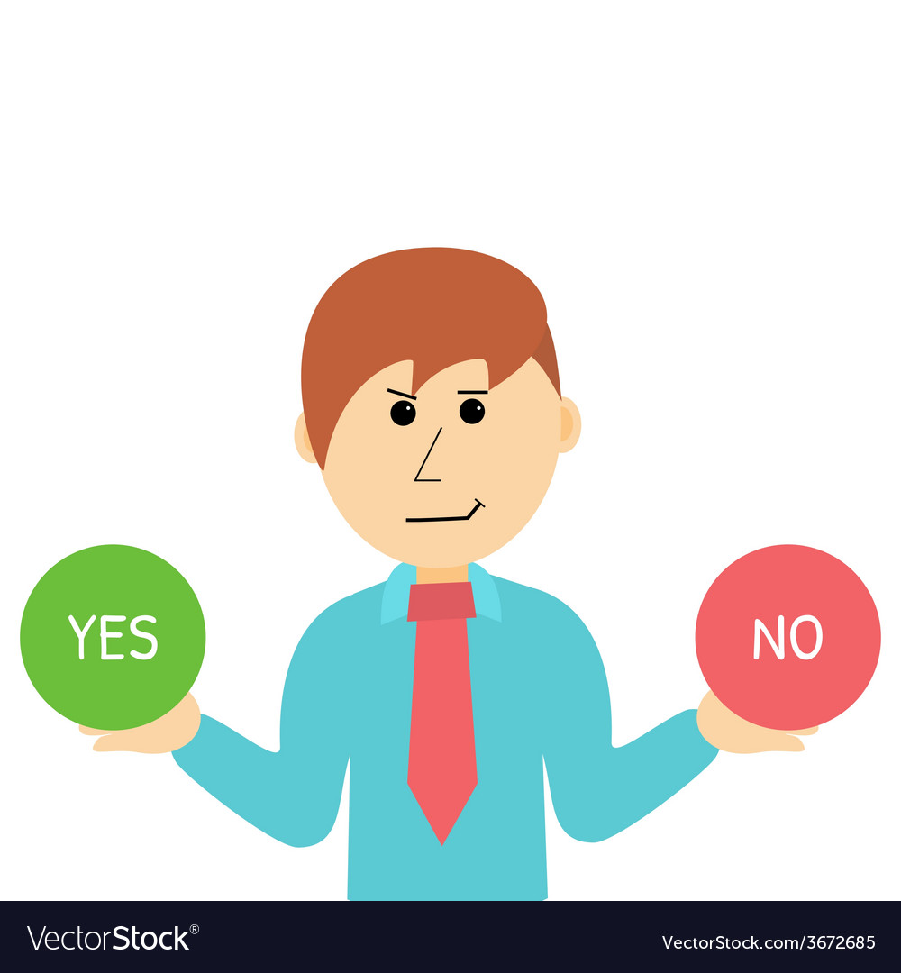
Concept of CDS
CDS Stands for Core Data & Services, it is an enhancement of Open SQL in ABAP layer. It is a language provided by SAP to create semantically rich data models (annotations).
What has been enhanced?
DDL (Data Definition language) – define new tables and objects
DCL (Data Control Language) - security
DQL (Data Query language) – CDS View
Expression Language
Can I create CDS views if my company is not on HANA DB?
YES, unlike AMDP we can Create CDS views on Any DB. But recommended for best performance is HANADB.
Which layer do we build CDS views?
ABAP Layer using ADT tool only. You cannot use SAPGUI
Which is the minimum NW version required to create CDS?
NW 7.4 SP6 and above with ANY DB
Is CDS only used to create Views alone?
No

Slide 7

Concept of CDS
Is CDS View same as HANA Calculation View?
NOT at all. Calculation views are native HANA objects, CDS views are ABAP layer managed. Eventually the runtime object is a HANA DB View.
What are all the types of CDS Views?
Parameterized and Non Parameterized CDS View. HANA CDS and ABAP CDS
I have heard about ABAP CDS and HANA CDS, are they same, what's the difference?
When we use ABAP language, we will always work with ABAP cds. HANA CDS is a native Hana development concept. Both are different flavor of similar concept. This course, focus only on ABAP CDS. https://www.youtube.com/watch?v=rTsAg_OGh-A
If I got to choose between AMDP and CDS, which should be first choice?
CDS views because, they are simple, easy and work with any DB. Not complex as AMDP’s are. Client handling is free with cds.

Slide 8
Concept of CDS
What is the actual code to data object which creates inside HANA when a CDS is created?
When we activate (not when we run), a HANA View will get created inside of HANA DB in SAPHANADB schema. Hence its also a code-to-data with top-down approach.
Can I create/edit CDS views using SAPGUI?
NO
What is the best practice/nami-convension to build CDS views in SAP?
CDS VDM (Virtual Data Modeling) – Private, Interface, Composite and Consumption views
Can I find standard CDS views delivered by SAP?
Yes SAP deliver more than 8000+ standard views. We can view them per LoB for S/4HANA Solution to a central directory provided by SAP – SAP Business API HUB

Slide 9
Concept of CDS
Can I also change the standard CDS views which SAP Delivers?
NO, its standard but we can build extension.
Is it possible to update the data in database using CDS view?
NO it’s a view. But if we add CDS with a framework like BOPF, we can insert/update/delete data as well.
What is CDS entity, I heard that CDS views are now deprecated and entity take its place?
Yes, CDS entity is a new concept, with very minor improvement over CDS views.
Can I integrate SQL Script Logic/ AMDP with CDS Views?
Yes, using a new concept called CDS table function which we will also cover in this course.
How to create OData services using cds views.
Please go through the complementary OData basic view from our training blog before next class.

Slide 10

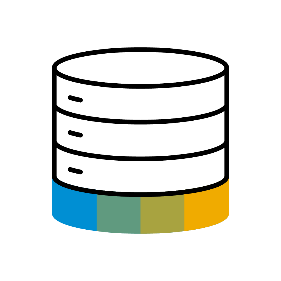
Paradigm Changes in Application Programming
Data-to-Code Intensive computations in APPLICATION layer
Application Programming Models
Classic Approach
Data Centric Approach
Database
Code-to-Data Intensive computations in DATABASE layer

Slide 11
A Family of Domain Specific Language
functions
functions
DDL
Define authorizations for DDL views
Modelled and declarative approach
Integrates with classic authorization concepts
DCL
Data modelling and retrieval on a higher semantic level
Extends native SQL leads to higher productivity
Data Definition Language
Query Language
Data Control Language
functions
QL
Consume CDS entities via Open SQL in ABAP
Fully transparent SQL extensions

Slide 12
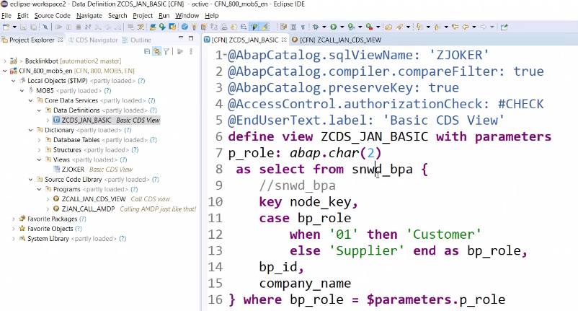
Creating CDS View
Create Basic CDS View with parameter and Data Expose from snwd_bpa (Business Partner Table) .

Slide 13
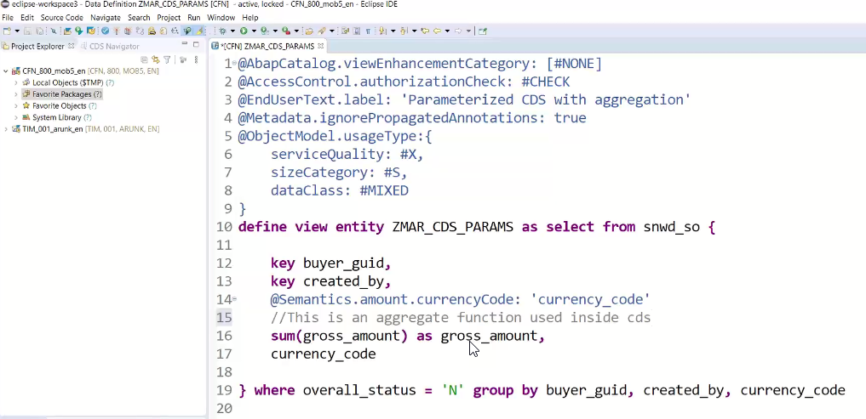
Core Data & Service Entities
A CDS entity has a specified number of columns, defined at the time of entity creation, but can have any number of rows. Database entities also typically have meta-data associated with them; the meta-data might include constraints on the entity or on the values within particular columns. SAP HANA Extended Application Services (SAP HANA XS) enables you to create a database entity as a design-time file in the repository. All repository files including your entity definition can be transported to other SAP HANA systems, for example, in a delivery unit. You can define the entity using CDS-compliant DDL.

Slide 14

Exercise
Basics of CDS View & CDS Entities Code

Slide 15
Challenges in CDS View
There are 3 objects which are having different names which cause confusion
We cannot give same name as CDS Entity name for our HANA View
The generated DDIC view is waste
Speed and Certain limitations
Sometimes, CDS Engine will also not check for certain errors @ Design
Starring SAP S/4HANA 2020, SAP Came-up with a new Concept Called CDS Entity
There is always one NAME
One object in ABAP and One in HANA
No DDIC view will generate anymore
Limitations overcome
Underlaying implementation is better
SAME CODE WILL WORK FOR CDS ENTITY ALSO. < S/4HANA2020

Slide 16

End of Day 11
Trainer: Anubhav Oberoy & Shubham Singh

Slide 17

Trainer: Anubhav Oberoy & Shubham Singh

Slide 18
THANK YOU
If you cannot do
great things, do small things in a great way.
Anubhav Oberoy & Shubham Singh
https://www.anubhavtrainings.com

Slide 19


We’re committed to empower you to be
Most Desirable Resource
through powerful training solutions.
We build the workforce of the future.
250+
Corporate Clients
30,000+
Learners Trained
25000+
Learners Placed
FREE WEBINARS
Sign up for free webinars with industry experts every fortnight!
Enroll Now!
Contact us today!
https://anubhavtrainings.com/

Slide 20




More from AnubhavTrainings.com

